Slide 1
AI USE CANVAS
Benefit: Reshaping business process Customer Engagement Employee productivity
Name:……………………………………………………………………
Work / Business Problem
Work Outcome
AI Role
How It Will Be Used in Daily Work
Work Content / Knowledge Needed
Users, Owners & Approvers
Risks, Boundaries & Human Review
Effort, Cost & Feasibility
Value & Success Measures

Slide 2
AI USE CANVAS
Benefit: Reshaping business process Customer Engagement Employee productivity
Name:……………………………………………………………………
WORKFLOW (AS-IS)

Slide 3
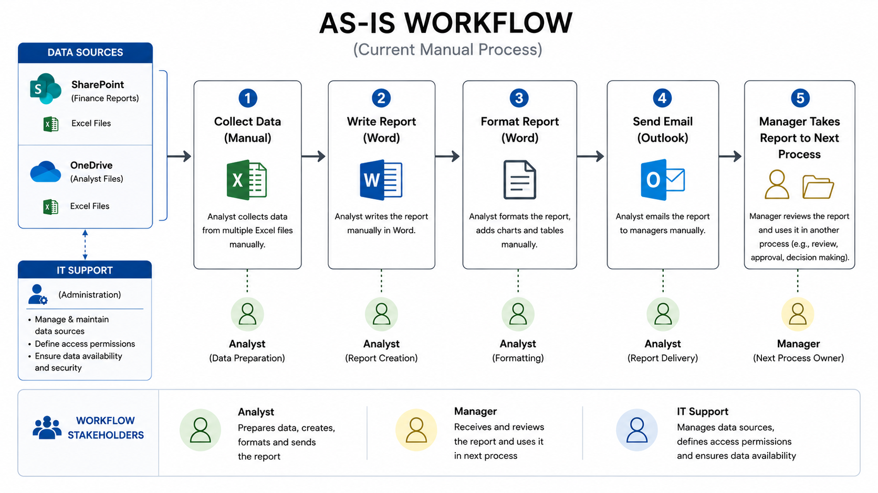

Slide 4
AI USE CANVAS
Benefit: Reshaping business process Customer Engagement Employee productivity
Name:……………………………………………………………………
WORKFLOW (TO-BE)

